Slide 1
AINT351: Machine Learning Lecture 9 Multilayer networks

Slide 2
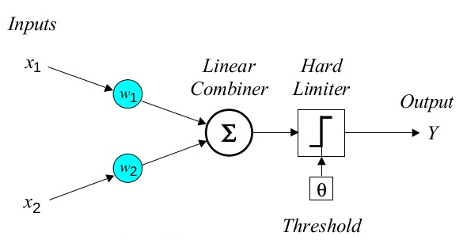
The perceptron
output z
(bias augmented into w)

Slide 3
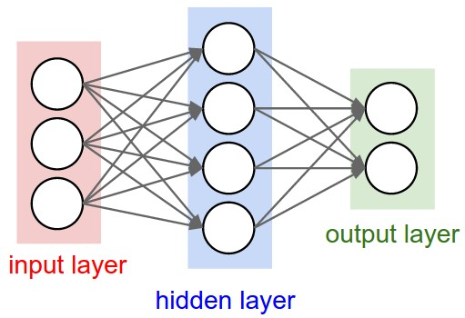
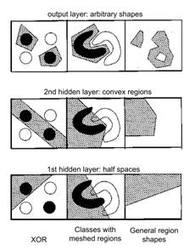
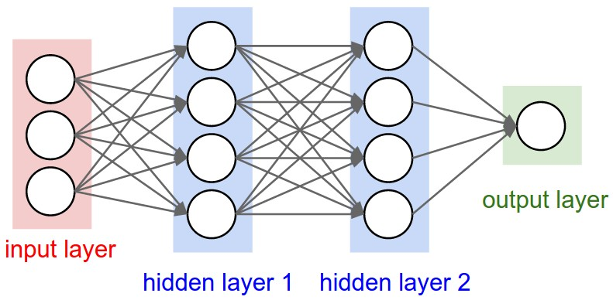
Multilayer networks
Multilayer layer network can implement more complex decision boundaries

Slide 4
AINT351: Machine Learning Lecture 9 Learning feature detectors

Slide 5
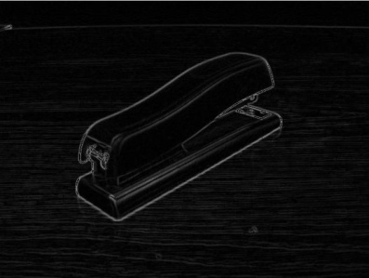
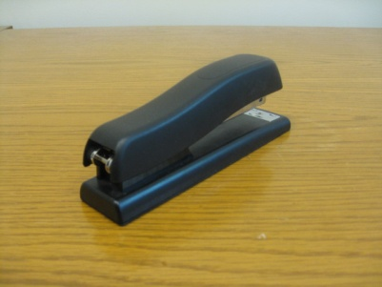

Example feature hierarchies
object models
object parts
(combination
of edges)
edges
pixels

Slide 6
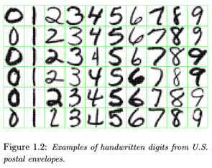
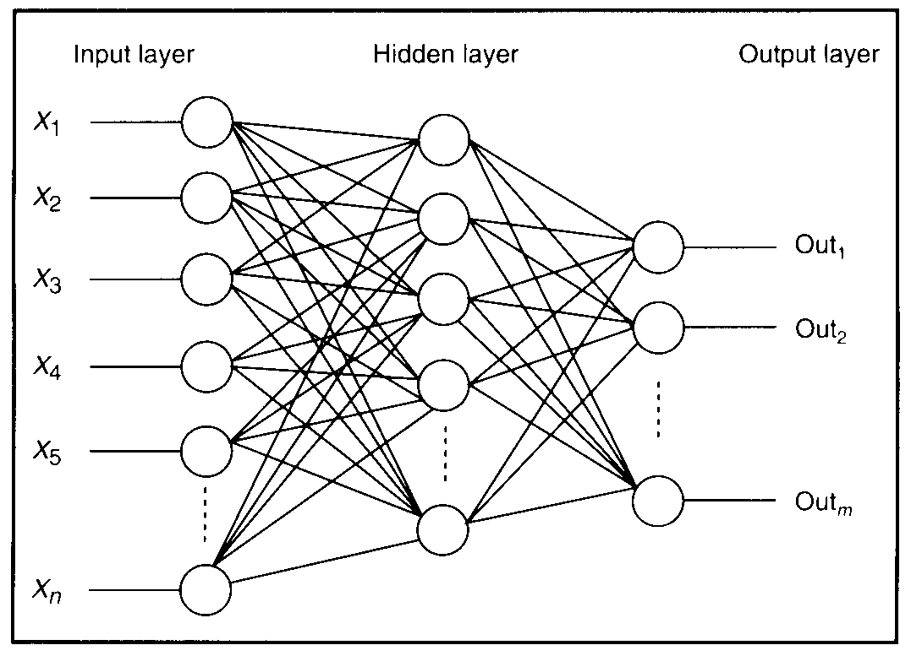
Feature detectors that develop in a MLP

Slide 7
What is this unit doing?

Slide 8
Hidden layer units become self-organised feature detectors
Self-organizing feature detectors
1 5 10 15 20 25 …
…
1
strong +ve weight
low/zero weight
63

Slide 9
What does this unit detect?
1 5 10 15 20 25 …
…
1
strong +ve weight
low/zero weight
63

Slide 10
What does this unit detect?
1 5 10 15 20 25 …
…
1
strong +ve weight
low/zero weight
It will send strong signal for a horizontal
line in the top row, ignoring everywhere else
63

Slide 11
What does this unit detect?
1 5 10 15 20 25 …
…
1
strong +ve weight
low/zero weight
63

Slide 12
What does this unit detect?
1 5 10 15 20 25 …
…
1
strong +ve weight
low/zero weight
Strong signal for a dark area in the top left
corner
63

Slide 13
What features get learned?
What features might you expect a good NN
to learn, when trained with data like this?

Slide 14
vertical lines
1
63

Slide 15
Horizontal lines
1
63

Slide 16
Small circles
1
63

Slide 17
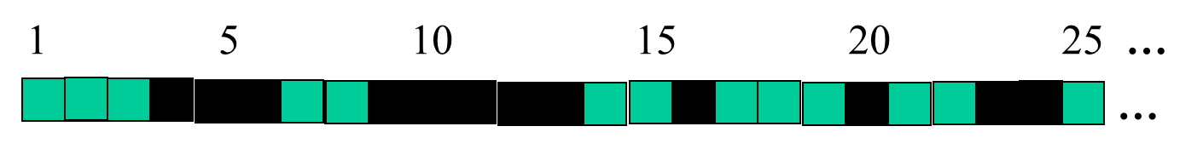
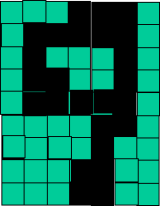
Successive layers can learn higher-level features
Deeper multi-layer NNs
Detect lines in
Specific positions
etc …
Higher level detetors
( horizontal line,
“RHS vertical lune”
“upper loop”, etc…
etc …
v

Slide 18
Deeper multi-layer NNs
Detect lines in
Specific positions
etc …
Higher level detetors
( horizontal line,
“RHS vertical lune”
“upper loop”, etc…
etc …
v
What does this unit detect?

Slide 19
AINT351: Machine Learning Lecture 9 Deep networks

Slide 20
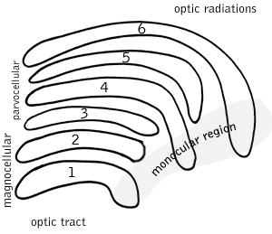
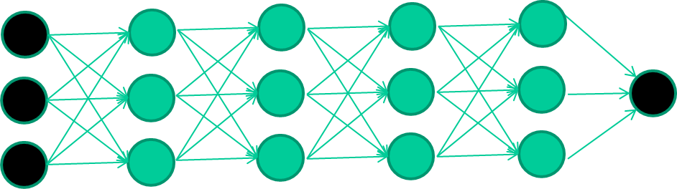
What is deep learning?
‘Deep Learning’ involves using a neural network with several layers of nodes between input and output
A series of layers between the input and output do feature detection and processing in a series of stages
Model of human visual system
Use recent algorithms for training many-later networks

Slide 21
Deep networks
Two main types of deep networks
Convolutional Neural Networks
Employ alternating layers of convolutional networks followed by a pooling layer
Output uses a traditional MLP
Deep Belief Networks
Consist of perceptron stacked Boltzmann machines
Use classification output layer

Slide 22
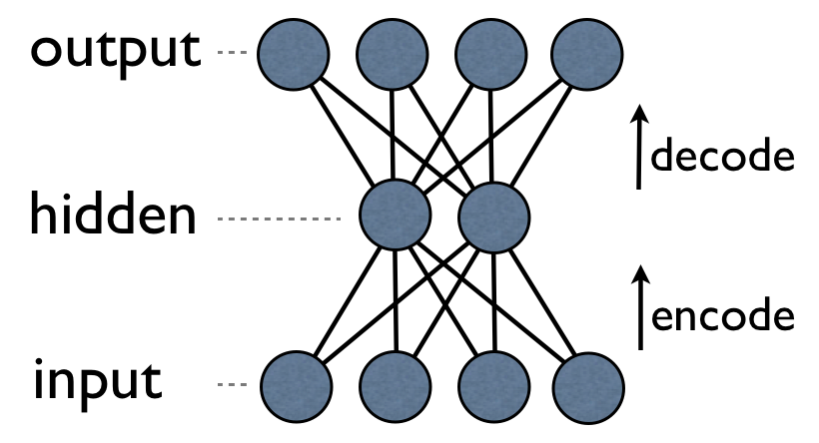
Auto encoder
An auto-encoder is trained with standard training algorithm
It learns to map the input back onto itself

Slide 23
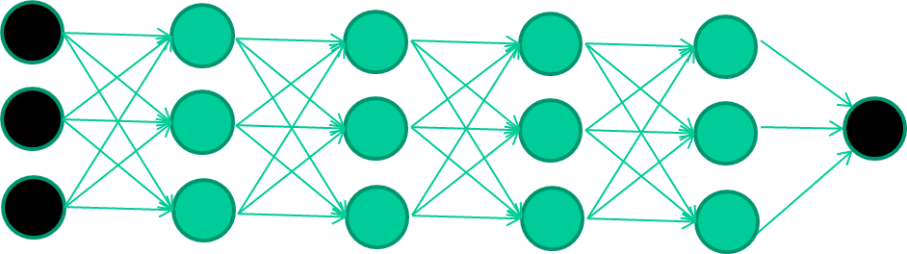
New way to train multi-layer NNs
Use greedy layer-wise training to train multilayer networks
Train first layer using data unsupervised without labels
Use abundant unlabeled data which is not part of the training set
Freeze the first layer parameters and start training the second layer using the output of the first layer as the unsupervised input to the second layer

Slide 24
New way to train multi-layer NNs
Repeat this for as many layers as desired
This builds a set of robust features
Use the outputs of the final layer as inputs to a supervised layer/model and train the last supervised layer(s) (leave early weights frozen)
Unfreeze all weights and fine tune the full network by training with a supervised approach, given the pre-processed weight settings

Slide 25
New way to train multi-layer NNs
Each of the (non-output) layers is trained to be an auto-encoder
Essentially it is forced to learn good features that describe what comes from the previous layer

Slide 26
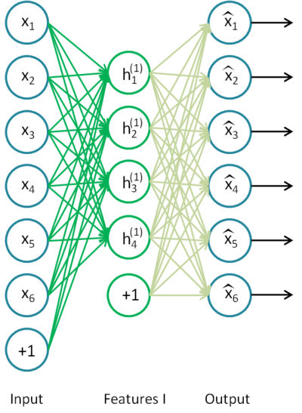
First train auto encoder on raw inputs

Slide 27
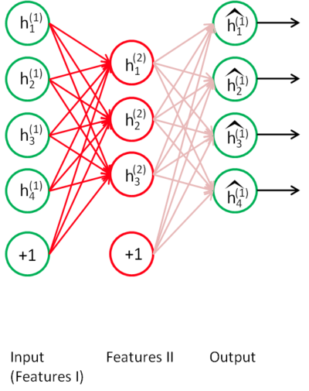
Use features 1 as raw input to auto encoder

Slide 28
New way to train multi-layer NNs
Train this layer first

Slide 29
New way to train multi-layer NNs
Train this layer first
then this layer

Slide 30
New way to train multi-layer NNs
Train this layer first
then this layer
then this layer

Slide 31
New way to train multi-layer NNs
Train this layer first
then this layer
then this layer
then this layer

Slide 32
New way to train multi-layer NNs
Train this layer first
then this layer
then this layer
then this layer
finally this layer

Slide 33
Advantages of greedy layer-wise training
Avoids many of the problems of trying to train a deep net in a supervised fashion
Each layer gets full learning focus in its turn since it is the only current "top" layer
Can take advantage of unlabeled data
When you finally tune the entire network with supervised training the network weights have already been adjusted so that you are in a good error basin and just need fine tuning.
This helps with problems of
Ineffective early layer learning
Deep network local minima

Slide 34
AINT351: Machine Learning Lecture 9 Convolutional networks

Slide 35
The replicated feature approach
Use many different copies of the same feature detector with different positions.
Could also replicate across scale and orientation (tricky and expensive)
Replication greatly reduces the number of free parameters to be learned.
Use several different feature types, each with its own map of replicated detectors.
Allows each patch of image to be represented in several ways.
The red connections all have the same weight.

Slide 36
Effect of replicating feature detectors
Equivariant activities: Replicated features do not make the neural activities invariant to translation. The activities are equivariant.
Invariant knowledge: If a feature is useful in some locations during training, detectors for that feature will be available in all locations during testing.
representation by active neurons
translated representation
translated image
image

Slide 37
Pooling replicated feature detector outputs
Get a small amount of translational invariance at each level by averaging four neighboring replicated detectors to give a single output to the next level.
This reduces the number of inputs to the next layer of feature extraction, thus allowing us to have many more different feature maps.
Taking the maximum of the four works slightly better.
Problem: After several levels of pooling, we have lost information about the precise positions of things.
This makes it impossible to use the precise spatial relationships between high-level parts for recognition.

Slide 38

Convolutional networks
Convolution in the integral of the product of the two functions after one is reversed and shifted
Same as sliding a single instance of the detector over input
Performs convolution like an FIR filter
Each convolution layer contains multiple feature maps (just as hidden layers typically multiple nodes), so each map is a single feature detector
Repeatedly applied to a small window across the whole input

Slide 39
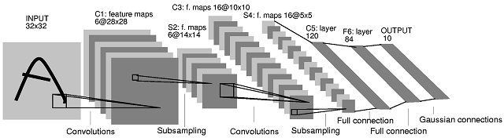
Convolutional networks
A convolutional neural network is are tiled in such a way that they respond to overlapping regions in the input field
Convolutional layer consists of units that act as feature detectors
Each convolutional unit is connected to a small region of the input
This structure is replicated for all offsets across the input data to span there input space

Slide 40
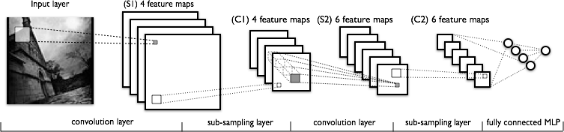
Convolutional networks
Thus the augmented connection weights are shared for all the hidden units in this feature map
Each layer combines patches from previous layers
Typically tries to compress large data into a smaller set of robust features, based on local variations
Convolution can create many features

Slide 41
Pooling layer
A pooling layer often follows a convolution layer
It down-samples the feature map
This step can compress and smooth the data
Make data invariant to small translational changes
Usually takes the average or max value across disjoint patches
Feature outputs are pooled independently

Slide 42
Final MLP layer
To make decisions a final MLP is often used
This can then make discrete classifications of the input

Slide 43
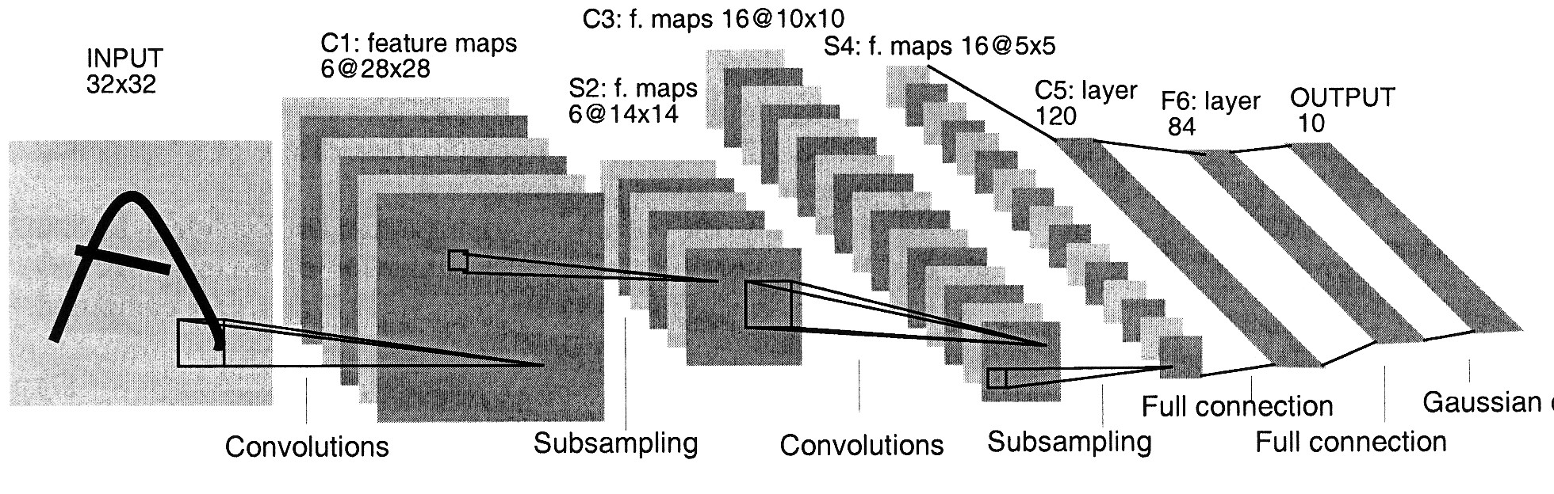
Le Net
Yann LeCun developed really good recognizer for handwritten digits using backpropagation in a feedforward net with:
Many hidden layers
Many maps of replicated units in each layer.
Pooling of the outputs of nearby replicated units.
A wide net that can cope with several characters at once
A clever way of training a complete system, not just a recognizer.

Slide 44
Acknowledgements
The internet
Slides based on slides- sometimes completely - from
David Wolfe Corne
Geoffrey Hinton
http://ufldl.stanford.edu/wiki/index.php/Main_Page

